Slide 1
HEART DISEASE PREDICTION
ILLIA LYSENNYI - X00220405
EMMANUEL FULFILLED - X00227373
LEO ENNIS - X00226717

Slide 2

Introduction
For this 3rd iteration of project development, we were focused on the models used to solve the problem.
With some final data prep for our models by splitting and shuffling the data.
We all chose one model to work on, and those models were Logistic Regression, Random Forest, and XGBoost

Slide 3

Models & Results

Slide 4
Why XGBoost
The XGBoost algorithm constructs trees in a sequential manner because each new tree serves to correct the errors which the earlier trees generated, which makes it the most precise model for our 918-row patient dataset that has structured tabular data.
We found is that this model is good for medical prediction based on research papers, so we decided to try this.
Also we wanted to try a new model and this model was good for this purpose.

Slide 5
Why Logistic Regression
We chose logistic regression as our model because it's great for smaller datasets and with ours having 918 rows, we thought it was a good fit.
The model is also meant for binary targets (1, 0) which is perfect for a problem like predicting the presence of a disease.

Slide 6
Why Random Forest
We chose Random Forest because it handles complex relationships in the data and works well with structured clinical features.
It is also robust, reducing overfitting by combining multiple decision trees for more accurate predictions.

Slide 7
Train/Test Split
We used a stratified 80/20 split, with 80% of our data dedicated to training and the other 20% for testing out model and we shuffled the data.
We chose that split because its standard for datasets of our size and we believe that it is the best fit for us.
This allows use to train an effective model that responds well to new data, and it helps prevent overfitting.

Slide 8
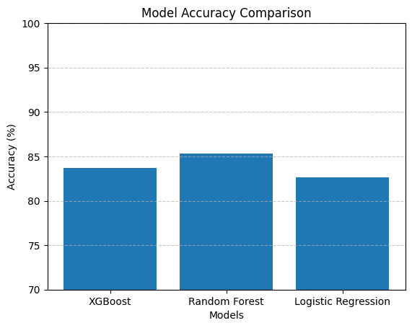
Comparison Table

Slide 9
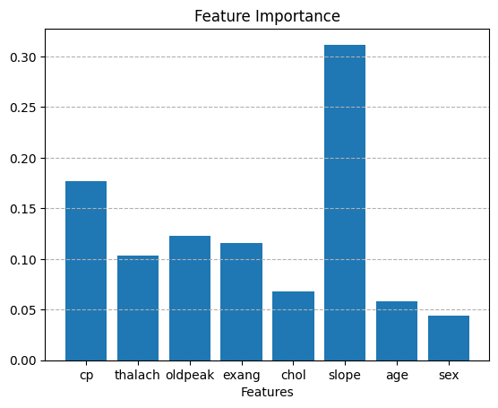
Feature Comparison

Slide 10

Conclusions
After this, we know which model we should use, based on similar cases where we need to predict the outcome of a disease using a medical dataset.
We also become more confident and professional in term of data preparation
It also expanded our knowledge of how and where we can apply these models, which will help us in the future

Slide 11
Source Data
Link of research papers:
XGBoost
https://xgboost.readthedocs.io/en/stable/faq.html
2. Logistic Regression
https://www.ibm.com/think/topics/logistic-regression
3. Random Forest
https://www.nvidia.com/en-us/glossary/random-forest/

Slide 12
Thanks!

